Slide 1
NOSQL
Καλύβας Εμμανουήλ
Νταούλας Βασίλειος
Document stores

Slide 2
Content
Add your first bullet point here
Add your second bullet point here
Add your third bullet point here

Slide 3
What is a document store?
A document store (also known as a document-oriented database or a document database) is a database that stores and retrieves information in documents (i.e. JSON or XML).
Non-relational databases. Instead of storing data in fixed rows and columns, document databases use flexible documents.
2-way access:
By key-value
By an attribute value
Flexible, Fast, Scalable, Schemaless

Slide 4

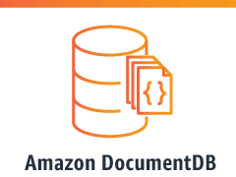


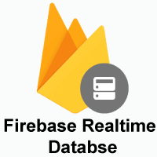
Examples

Slide 5
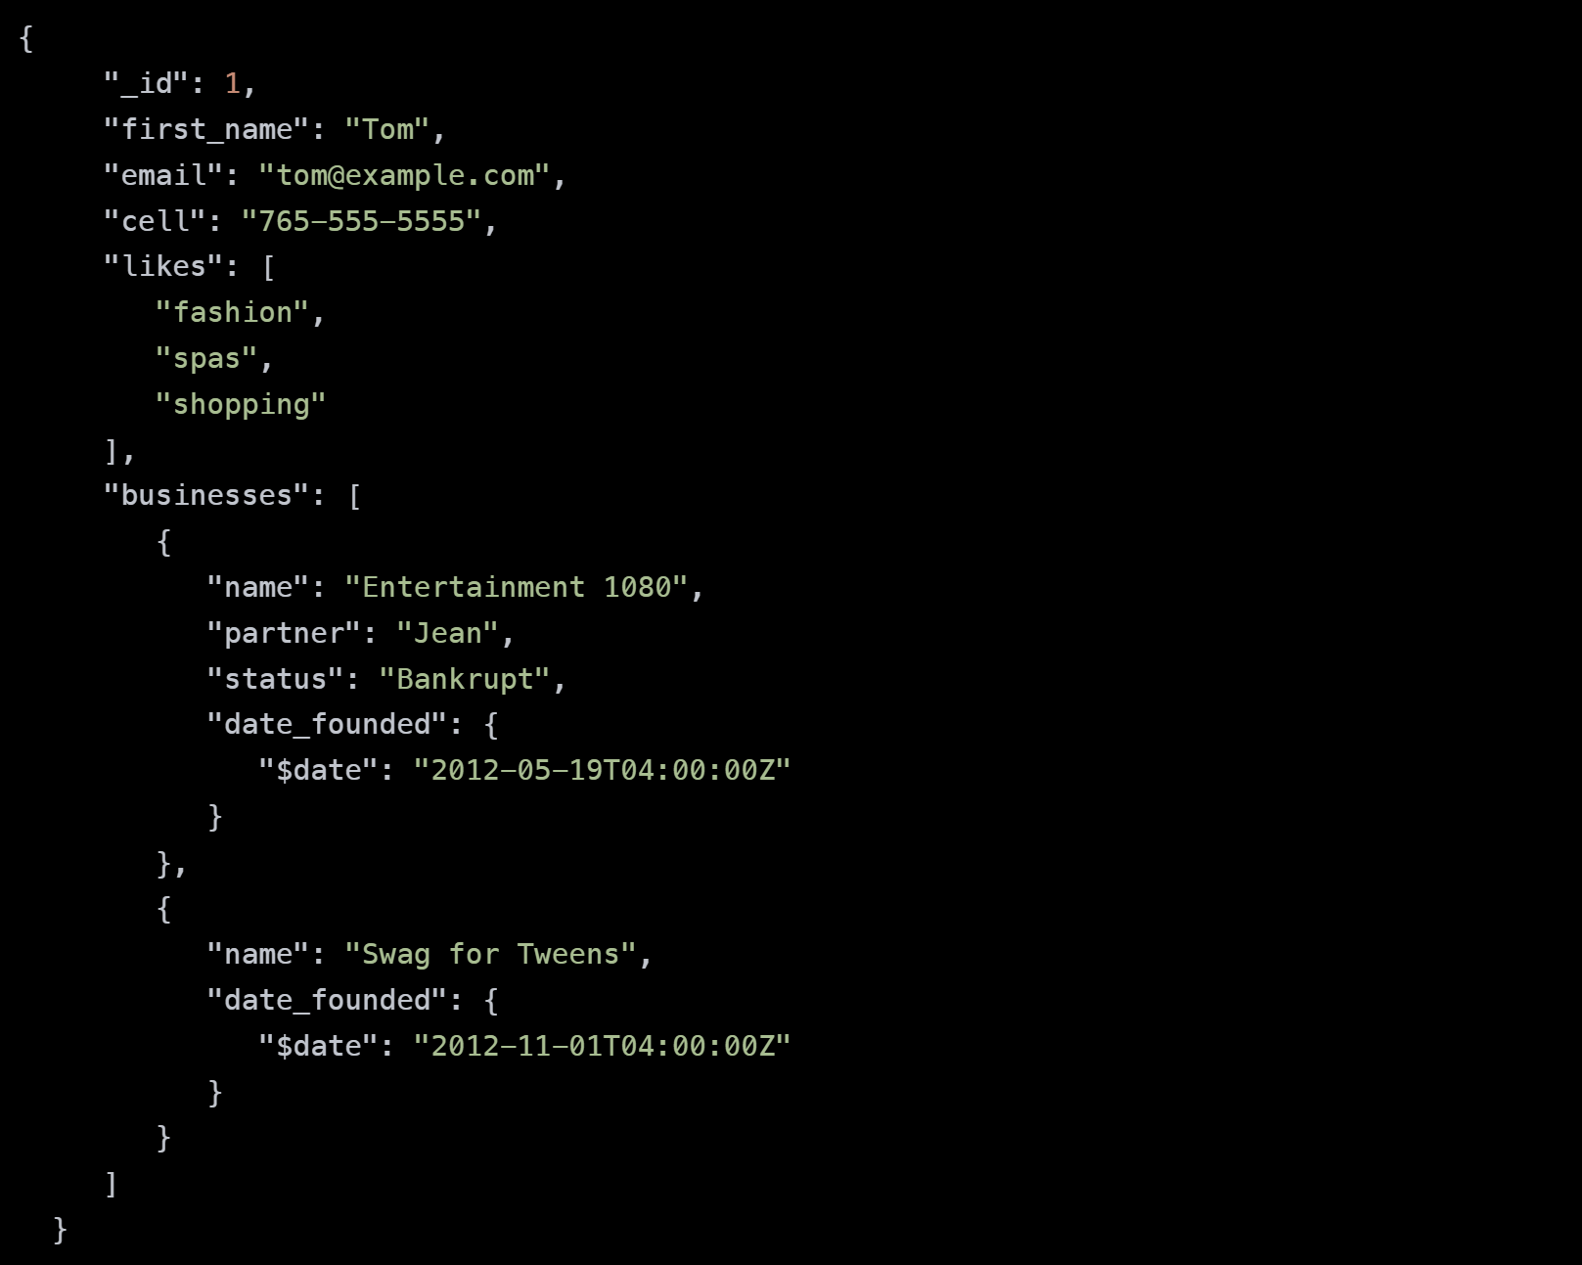
a JSON document that stores information about a user named Tom.

Slide 6
Key features
A document store (also known as a document-oriented database or a document database) is a database that stores and retrieves information in documents (i.e. JSON or XML).
Non-relational databases. Instead of storing data in fixed rows and columns, document databases use flexible documents.
2-way access:
By key-value
By an attribute value
Flexible, Fast, Scalable, Schemaless

Slide 7
Differences between relational DBs
A document store (also known as a document-oriented database or a document database) is a database that stores and retrieves information in documents (i.e. JSON or XML).
Non-relational databases. Instead of storing data in fixed rows and columns, document databases use flexible documents.
2-way access:
By key-value
By an attribute value
Flexible, Fast, Scalable, Schemaless

Slide 8
Title and Content Layout with Chart

Slide 9
Two Content Layout with Table
First bullet point here
Second bullet point here
Third bullet point here
Class | Group 1 | Group 2
Class 1 | 82 | 95
Class 2 | 76 | 88
Class 3 | 84 | 90

Slide 10
Title and Content Layout with SmartArt
Step 1 Title
Step 2 Title
Task description
Task description
Task description
Task description
Task description
Task description
Task description
Step 3 Title
Task description
Task description
Step 4 Title
Task description
Task description

Slide 11
Add a Slide Title - 1

Slide 12
REFERENCES
Link: https://www.mongodb.com/document-databases
Link: https://database.guide/what-is-a-document-store-database/
Lectures from lesson

Slide 13
THANK YOU!

